Slide 1
FASHION MNIST
By:
VARSHA(21BD5A0513)
VAISHNAVI(21BD5A0516)
SREEYA(21BD5A0518)
MOLLY(20BD1A0555)

Slide 2
OBJECTIVE
The Fashion MNIST dataset is a large freely available database of fashion images that is commonly used for training and testing various machine learning algorithms.
The objective of this project is to utilize different machine learning models to classify fashion item images in the Fashion-MNIST dataset into certain categories.

Slide 3
What is Fashion MNIST?
MNIST stands for (Modified National Institute of Standards and Technology)
Fashion MNIST is a dataset consisting of a training set of 60,000 examples and a test set of 10,000 examples.
Each example is a 28X28 grayscale image, associated with a label of 10 classes.
We try to serve as a direct drop-in replacement for the original MNIST dataset for benchmarking machine learning algorithms.
It shares the same image size and structure of training and testing splits.

Slide 4
LITERATURE SURVEY
Key Studies and Contributions
Original Fashion MNIST Paper (2017): The Fashion MNIST dataset was introduced by Han Xiao in 2017 as an alternative to the traditional MNIST dataset of handwritten digits. This dataset quickly gained popularity due to its applicability in real-world scenarios, making it an essential resource for the computer vision community.
Benchmarking Convolutional Neural Networks (CNNs): Many studies have used Fashion MNIST to benchmark the performance of various CNN architectures. Researchers have achieved high accuracy in fashion item classification, often surpassing 90% accuracy, thus demonstrating the effectiveness of CNNs in image recognition tasks.
Transfer Learning and Pre-trained Models: Fashion MNIST has been used to evaluate transfer learning techniques, where pre-trained models (e.g., ResNet, VGG) on large datasets like ImageNet are fine-tuned for this dataset. This approach has shown that pre-trained models can significantly boost classification performance on Fashion MNIST with minimal training data.

Slide 5
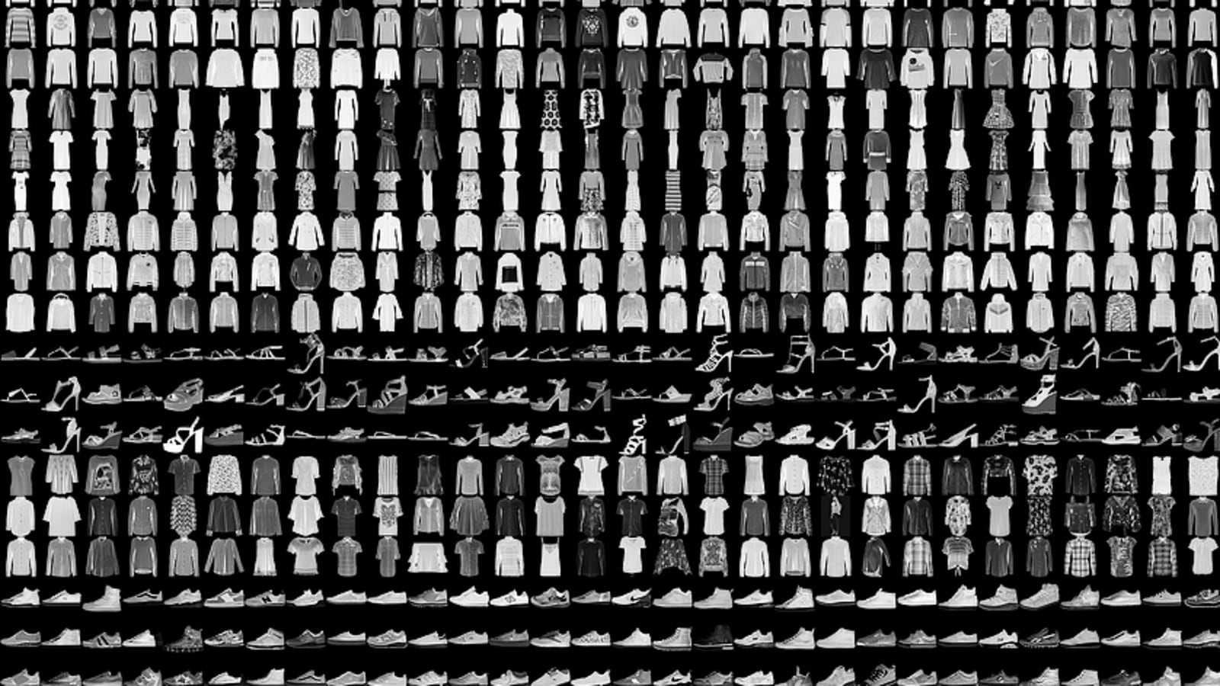
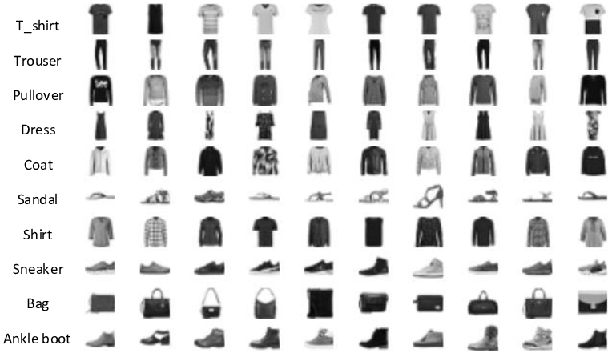
Fashion MNIST Dataset

Slide 6
MNIST Dataset
Fashion-MNIST is a dataset comprising of 28×28 grayscale images of 70,000 fashion products from 10 categories, with 7,000 images per category. The training set has 60,000 images and the test set has 10,000 images.

